Slide 1
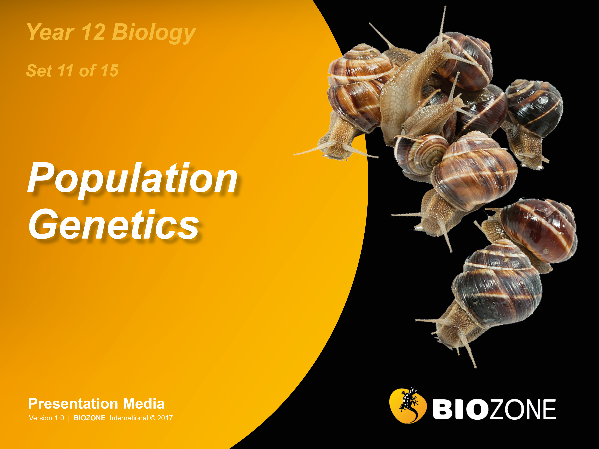

Slide 2
Gene pools
Darwinism
Gene pools
Natural selection
Modes of natural selection
Adaptations and fitness
Selection for skin colour
Darwin’s finches
Peppered moths
Heterozygote advantage
Antibiotic resistance
Pesticide resistance
Influenzavirus
Population genetics
Gene flow
The founder effect
Population bottlenecks
Genetic drift

Slide 3
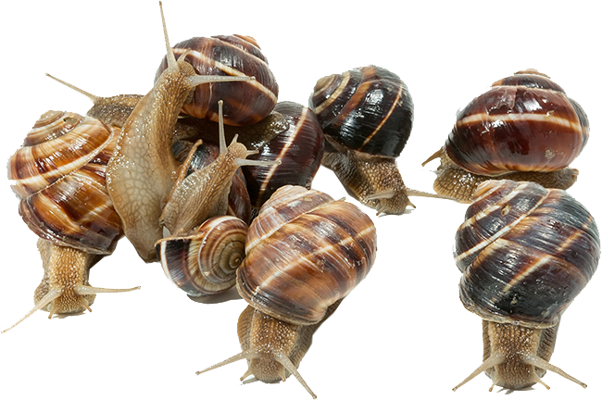
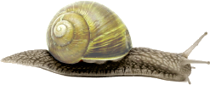
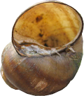
The Concepts of Darwinism
Darwin’s view of life was of ‘descent with modification’: “descendants of ancestral forms adapted to different environments over a long period of time.”
The mechanism for adaptation is called ‘natural selection’ and is based on a number of principles:
Overproduction
Variation
Competition
Survival of the fittest phenotype
Favourable combinations become more common

Slide 4
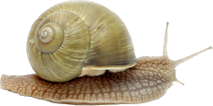
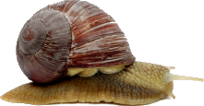
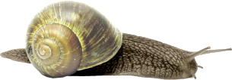
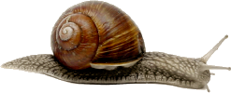
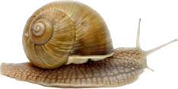
The Concepts of Darwinism
The mechanism for adaptation is called ‘natural selection’ and is based on a number of principles:
Overproduction: Species produce more young than will survive to reproductive age (they die before they have offspring).
Variation: Individuals vary in many characteristics (even siblings differ). Some variations are better suited to the conditions of the time than others.
Competition: There is competition for limited resources (e.g. food).
Survival of the fittest phenotypes: The individuals with the most favourable combinations of characteristics will be most likely to survive and pass on their genes to the next generation.
Favourable combinations become more common: Each new generation will contain proportionally more descendants of individuals with favourable characteristics.

Slide 5
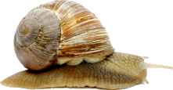
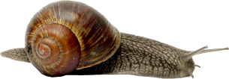
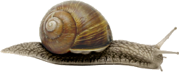
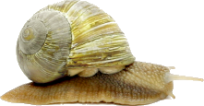
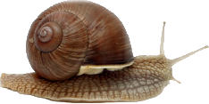
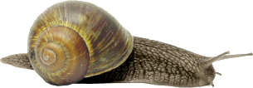
Natural Selection
Overproduction
Populations produce too many young: many must die
Variation
Individuals show variation: some variations are more favourable than others
Natural selection
Natural selection favours the best suited at the time
Inheritance
Variations are inherited. The best suited variants leave more offspring.

Slide 6
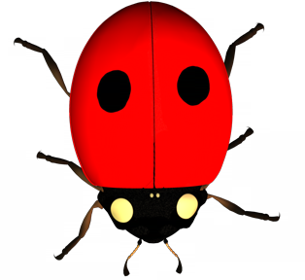
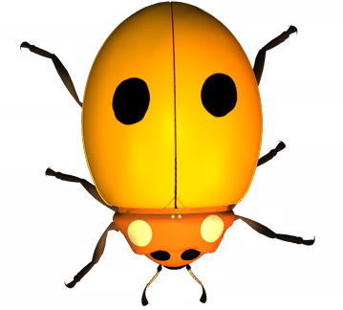
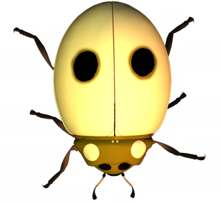
Gene Pool
A gene pool made up of 16 individuals
AA
Aa
A gene pool is defined as the sum total of all the genes present in a population at any one time.
Not all the individuals will be breeding at a given time.
The population may have a distinct geographical boundary.
Each individual is a carrier of part of the total genetic complement of the population.
AA
AA
aa
Aa
aa
Aa
aa
Aa
AA
AA
aa
Aa
AA
Aa
For quick visual recognition, heterozygotes are shown as a different colour. In reality, they would have the same phenotype as AA.

Slide 7
Gene Pool
Geographic boundary of the gene pool
Individual is homozygous recessive (aa)
AA
Aa
aa
AA
AA
Aa
Aa
Individual is homozygous dominant (AA)
aa
aa
AA
Aa
aa
Aa
Aa
AA
AA
aa
Individual is heterozygous (Aa)
A gene pool made up of 16 individual organisms with gene A, where gene A has two alleles

Slide 8
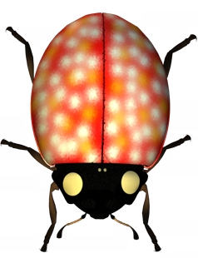
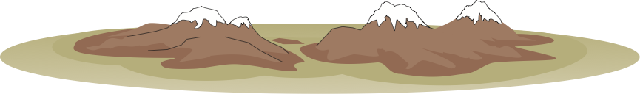
Changing Allele Frequencies
Emigration
AA
aa
Aa
aa
AA
Aa
AA
Aa
Aa
Aa
Immigration
Aa
AA
Aa
Aa
aa
Aa
Aa
AA
AA
aa
AA
A’A
Aa
Boundary of gene pool
Natural selection
Mutation
Mate selection (non-random mating)
Gene flow
Geographical barrier
Aa
Aa
Aa
Aa
aa
Aa
AA
Aa
aa
aa
Aa
Aa
aa
aa
Aa
aa
Genetic drift

Slide 9
Determining
Allele Frequencies
To determine the frequencies of alleles in the population, count up the numbers of dominant and recessive alleles, regardless of the combinations in which they occur.
Convert these to percentages by a simple equation:
Aa
AA
aa
Aa
Aa
AA
No. of dominant alleles
Aa
X 100
Aa
Total no. of alleles
Aa

Slide 10
Determining
Genotype Frequencies
To determine the frequencies of different genotypes in the population, count up the actual number of each genotype in the population:
homozygous dominant (AA)
heterozygous (Aa)
homozygous recessive (aa).
Aa
AA
aa
Aa
Aa
AA
Aa
Aa
Aa

Slide 11
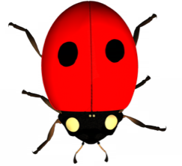
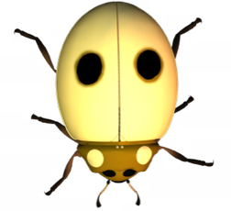
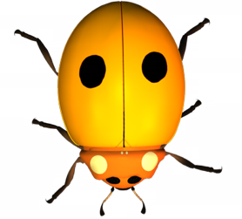
Changes in a Gene Pool 1
Phase 1: Initial gene pool
In the gene pool below there are 25 individuals, each possessing two copies of a gene for a trait called A.
This is the gene pool before changes occur:
A | a | AA | Aa | aa
27 | 23 | 7 | 13 | 5
54 | 46 | 28 | 52 | 20
No.
%
Allele types
Allele combinations
aa
AA
Aa
Aa
Aa
AA
aa
Aa
Aa
AA
AA
Aa
Aa
Aa
Aa
Aa
aa
AA
Aa
aa
Aa
aa
AA
AA
Aa

Slide 12
Changes in a Gene Pool 2
Phase 2: Natural selection
In the same gene pool, at a later time, two pale individuals die due to the poor fitness of their phenotype.
A | a | AA | Aa | aa
27 | 19 | 7 | 13 | 3
58.7 | 41.3 | 30.4 | 56.5 | 13
No.
%
Two pale individuals died and therefore their alleles are removed from the gene pool
Allele types
Allele combinations
aa
AA
Aa
Aa
Aa
AA
Aa
aa
Aa
AA
AA
Aa
Aa
Aa
Aa
Aa
aa
AA
Aa
aa
Aa
aa
AA
AA
Aa

Slide 13
Changes in a Gene Pool 3
A | a | AA | Aa | aa
29 | 17 | 8 | 13 | 2
63 | 37 | 34.8 | 56.5 | 8.7
Phase 3: Immigration/Emigration
Later still, one beetle (AA) joins the gene pool, while another (aa) leaves.
No.
%
This individual is entering the population and will add its alleles to the gene pool
This individual is leaving the population, removing its alleles from the gene pool
Allele types
Allele combinations
AA
AA
Aa
Aa
Aa
AA
aa
Aa
Aa
AA
AA
Aa
Aa
Aa
Aa
Aa
aa
AA
Aa
Aa
aa
AA
AA
Aa

Slide 14
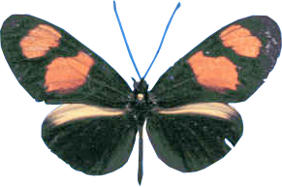
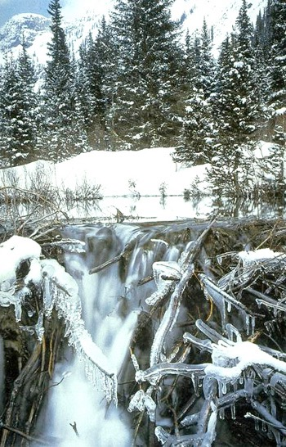
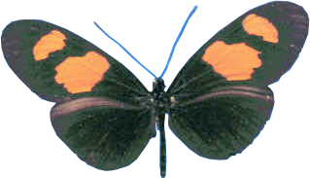
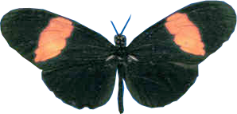

Modes of Natural Selection
Natural selection can result in changes in the allele frequencies in populations, but it does not produce the “perfect organism”.
Rather than producing new phenotypes, it reduces the frequency of phenotypes that are less suited to the prevailing conditions (e.g. increased frequency of heavy frosts).
Phenotypic characteristics (e.g. skin colour, height) that are under polygenic control show quantitative variation in the phenotype.
Natural selection acts on this variation as well as the variation arising from differences at a single locus, e.g. AA, Aa, aa.
AA
Aa
aa

Slide 15
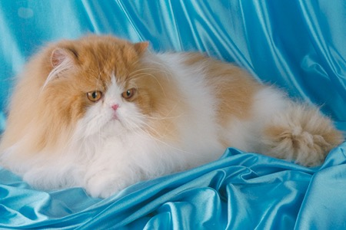
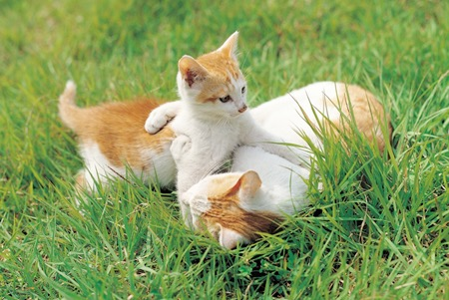
Adaptations and Fitness
Fitness is a measure of how well suited an organism is to survive in its habitat and its ability to maximise the numbers of offspring surviving to reproductive age.
Adaptations are distinct from properties which, although they may be striking, cannot be described as adaptive unless they are shown to be functional in the organism’s natural habitat.
COR
The fur of this cat is a striking property...
COR
Mothering and play behaviours are adaptive

Slide 16
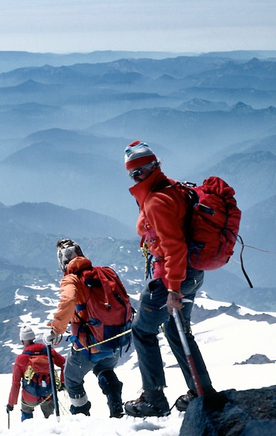
Acclimatisation
Acclimatisation (physiological adjustment) describes changes (usually physiological or behavioural) made during an individual’s lifetime to adjust to changing environmental conditions.
For example, when a person spends time at high altitude, physiological changes to the circulatory and respiratory systems improve efficiency in the thinner air.
These adjustments should not be confused with genetic adaptation.

Slide 17
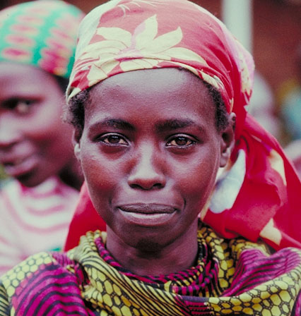
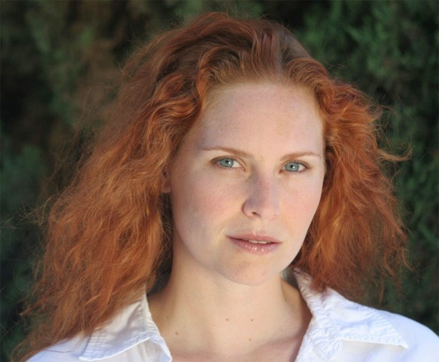
Selection for Skin Colour
The distribution of skin colour is not random.
People native to tropical and sub-tropical regions of the planet have darker skins than those of higher latitudes.
It was originally postulated that this had evolved as a mechanism to protect against skin cancer.
However skin cancer does not usually develop until well after reproductive age and therefore cannot influence fitness.
Population data indicates that skin colour is the final result of a balance between the need for vitamin D and the need to protect folate stores.
Selection is stabilising within latitudinal regions.
COR
COR

Slide 18
Vitamin D and Folate
The evolution of human skin colour is a result of two opposing selection pressures.
Folate is essential for neural development in the fetus so the mother must have high levels in her body.
Folate is broken down by ultraviolet light. A more pigmented (darker) skin protects folate from destruction by UV.
Pregnant and lactating women have a high requirement for calcium, which is required for normal skeletal development. Vitamin D is needed to absorb calcium from the diet.
Sunlight is needed for vitamin D synthesis, so the skin must be pale enough to enable this.
Serum folate (mg mL⁻¹)
Vitamin D (nmol L⁻¹)

Slide 19
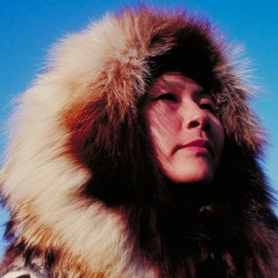
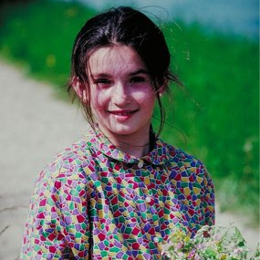
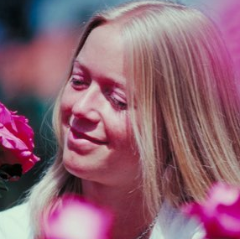
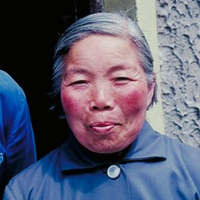
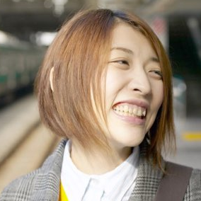
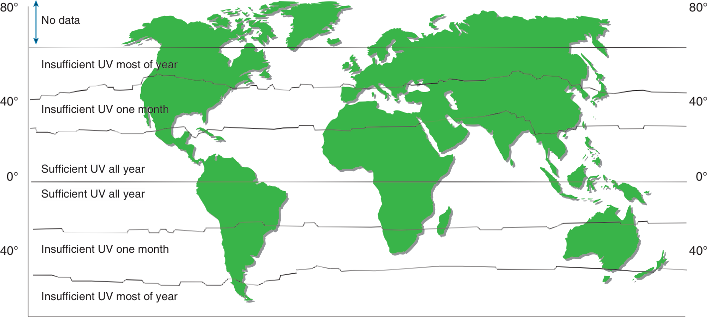
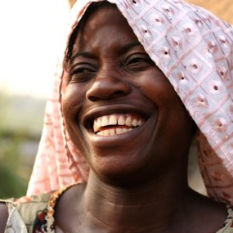
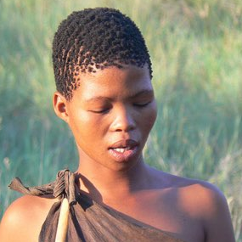
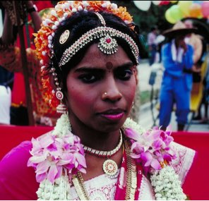
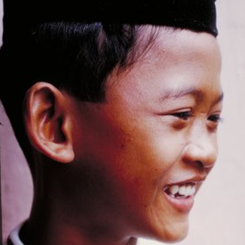
Skin Colour and Latitude

Slide 20
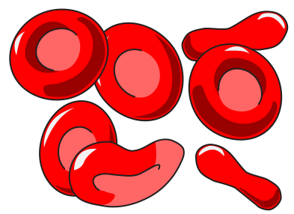
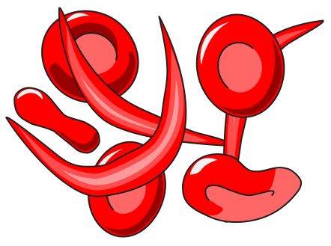

Heterozygote Advantage
Sometimes, individuals that are heterozygous for a gene (Aa) are more common in the population than would be expected.
This is because the heterozygous condition can have higher fitness than either homozygote (AA or aa).
This is termed heterozygote advantage.
Example: Individuals heterozygous for the sickle cell mutation have higher fitness that either homozygous conditions.
The sickle cell mutation produces haemoglobin differing by one amino acid in the beta chain. This causes red blood cells to deform and clump together, causing circulatory and organ function problems.
Hb, Hb
All red blood cells are normal
Hb^{S}, Hb
Mix of normal and sickle red blood cells
Hb^{S}, Hb^{S}
All red blood cells are sickle shaped

Slide 21
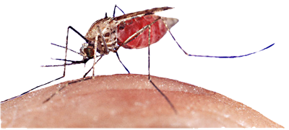
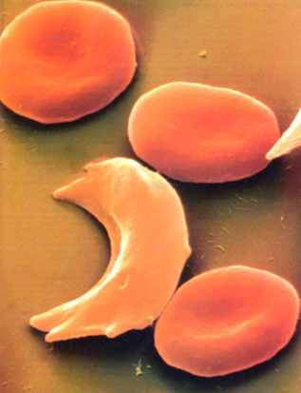
Sickle Cell Gene
The heterozygote advantage of the sickle cell mutation is apparent in regions where malaria is endemic. Why?
Malaria is transmitted by certain species of mosquito which spreads the intracellular protozoan parasite, Plasmodium.
Sickle cells have low potassium levels and the parasites infecting these cells die.
Individuals with a normal phenotype (Hb,Hb) are very susceptible to malaria. Heterozygotes (HbS,Hb) are much less so. Sickle cell homozygotes (HbS, HbS) die from sickle cell disease.
In regions where malaria is prevalent, the HbS allele is present in moderately high frequencies.
This is a balanced lethal system because neither of the homozygotes produces a phenotype with high fitness.
Anopheles mosquito
Normal cells
Sickle
cell
Photo Defiers.com
Sickle cell: note its pale appearance

Slide 22
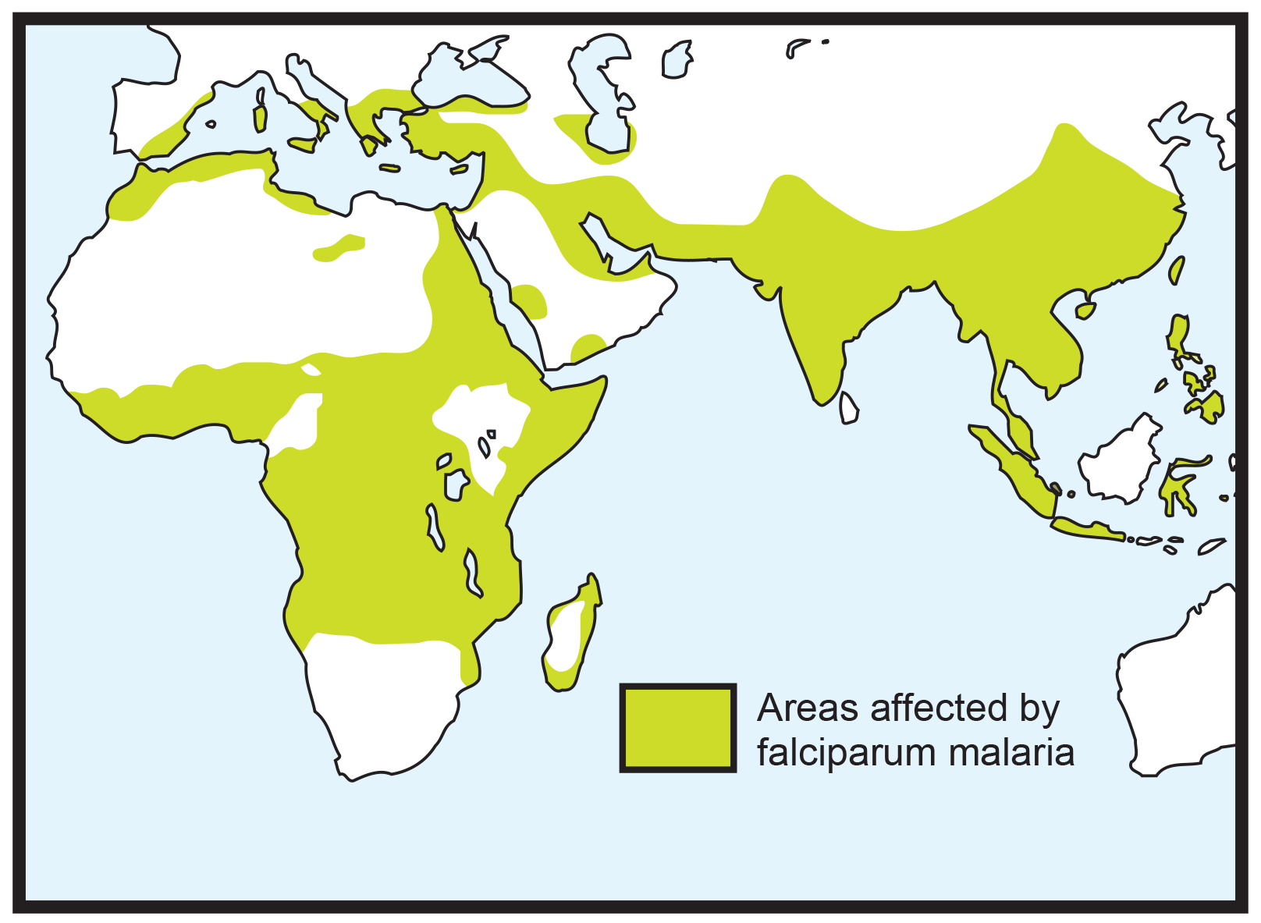
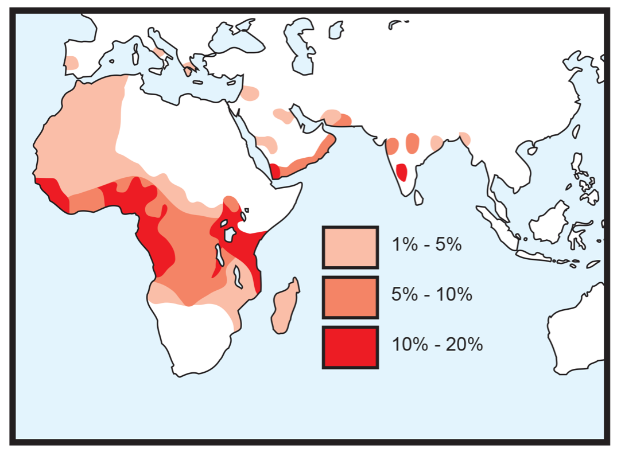
Sickle Cell Disease & Malaria
Frequency of sickle cell allele (Hb^{S})
Incidence of falciparum malaria
Falciparum malaria is a particularly virulent form of malaria caused by Plasmodium falciparum. Falciparum malaria can be fatal within days of the first symptoms appearing.
In large parts of the world, there is a good correlation between the incidence of falciparum malaria and the frequency of the Hb^{S} allele.

Slide 23
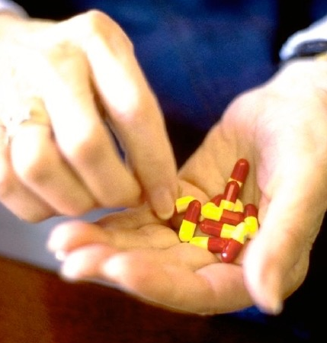
Antibiotic Resistance 1
The short generation time of bacteria (under 30 minutes in some species) allows for an enormous number of chances for mutation.
A mutation could impart some useful property in the current selective environment, e.g. resistance to antibiotics.
Any mutation that provides an advantage in a particular selective environment may spread quickly through a bacterial population.
The widespread use of antibiotics to treat infection has created the selective environment for increased frequency of antibiotic resistance genes in bacterial populations.
Photo: AT

Slide 24
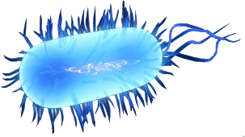




Antibiotic Resistance 2
Susceptible bacterium
Less susceptible bacterium
Mutations occur at a rate of one in every 10⁸ replications
Antibiotic resistance genes can be transferred to non resistant strains
The less susceptible bacterium survives
Fully resistant bacterium
Any population of bacteria includes variants with unusual traits. Mutations may spontaneously produce unusual or useful traits, e.g. resistance to a particular antibiotic.
Even less susceptible bacterium
Under the selective environment provided by the antibiotic, any individual with resistance will have an advantage. They may survive a certain dose of antibiotic and proliferate.
Some of the individuals in the growing population may be able to resist an even higher dose of the antibiotic. Their descendants will be favoured as long as the selective environment continues.

Slide 25


Causes of Drug Resistance
Resistance to drugs in pathogens generally results from:
Poor drug compliance: patients stop taking their medication or do not follow the treatment as directed.
Low levels of drug absorption: drug absorption is reduced if a patient has diarrhoea, is vomiting, or has an intestinal infection.
Individual variation: the effectiveness of the body to absorb, distribute, metabolise, and eliminate a drug varies between patients.
Toxicity: the side effects of the medication may make the patient very sick, so they stop taking it.

Slide 26

Structure of Influenzavirus
The neuraminidase (N) spikes help the virus to detach from the cell after infection.
Influenza strains are identified by the variation in their H and N surface antigens.
Influenza viruses are able combine and readily rearrange their RNA segments, which alters the protein composition of their H and N glycoprotein spikes.
Influenzavirus is surrounded by an envelope containing protein and lipids.
The viral genome is contained on eight RNA segments, which enables the exchange of genes between different viral strains.
The genetic material is actually closely surrounded by protein capsomeres (these have been omitted here).
Hemagglutinin (H) spikes allow the virus to recognise and attach to cells before attacking them.

Slide 27



Antigenic Shift in Influenzavirus
H1N1
Antigenic drifts are the small changes in the virus that happen continually over time.
Antigenic shifts occur when two or more different viral strains combine to form a new subtype.
H1N1, H1N2, and H3N2 are the known Influenza A viral subtypes currently circulating among humans.
Even if the body carries antibodies to other flu strains, the new combination of N and H spikes is different enough to allow new viral strains to avoid detection by the immune system.
Because of the constant changes in the virus, the flu vaccine must be updated every year.
H1N2
H3N2

Slide 28


Gene Flow
AA
Barriers to gene flow
Gene flow is the movement of genes into or out of a population (immigration and emigration).
A population may gain or lose alleles through gene flow.
Gene flow tends to reduce the differences between populations because the gene pools become more similar.
AA
Aa
AA
Aa
AA
Aa
Aa
Aa
AA
aa
AA
Aa
AA
Aa
Aa
Aa
aa
AA
aa
AA
AA
Aa
Aa
aa
aa
AA
AA
aa
aa
Aa
aa
AA
Aa
Aa
aa
Aa
Aa
AA
Aa
Aa
AA
Population A
AA
AA
Aa
Aa
aa
aa
Aa
Aa
aa
AA
No gene flow
aa
Aa
Population B
Population C
AA
Migration into and out of population B
AA
Aa
AA
Aa
AA
AA
Aa
Aa
Aa
AA
aa
AA
Aa
aa
AA
Aa
Aa
Aa
Aa
Aa
aa
aa
AA
AA
AA
aa
aa
Aa
aa
aa
AA
Aa
Aa
aa
AA
Aa
Aa
AA
Aa
Aa
AA
AA
AA
Aa
Aa
aa
aa
Population A
Aa
Aa
aa
AA
aa
Aa
Gene flow
Population B
Population C

Slide 29


Isolated Populations
Occasionally, a small number of individuals may migrate away or become isolated from their original population.
This colonising or founder population will have a small and probably non-representative sample of alleles from the parent population’s gene pool.
As a consequence of this founder effect, the colonising population may evolve in a different direction than the parent population.
Offshore islands can provide an environment in which founder populations can evolve in isolation from the parental population.
The marine iguana of the Galápagos has evolved in an isolated island habitat

Slide 30




The Founder Effect
Island
population
Small founder populations are subject to the effects of random genetic drift.
The founder effect is typically seen in the populations of islands which are colonised by individuals from mainland populations.
Often these species have low or limited mobility. Their dispersal is often dependent on prevailing winds (e.g. butterflies and other insects, reptiles, and small birds).
Colonisation
Mainland
population

Slide 31
The Founder Effect
Colonising island
population
Aa
AA
AA
AA
Aa
AA
Aa
Aa
In this hypothetical population of beetles, a small, randomly selected group is blown offshore to a neighbouring island where they establish a breeding population.
Some individuals from the mainland population are carried at random to the offshore island by natural forces such as strong winds
This population may not have the same allele frequencies as the mainland population
Mainland
population
Aa
AA
Aa
AA
aa
Aa
AA
AA
AA
Aa
Aa
Aa
aa
aa
Aa
AA
aa
Aa
AA
aa
AA
AA
aa
Aa
Aa
AA
Aa
AA
Aa
aa
AA
aa

Slide 32



Population Bottlenecks
Populations may be reduced to low numbers through periods of:
As a result, only a small number of individuals remain in the gene pool to contribute their genes to the next generation.
The small sample that survives will often not be representative of the original, larger gene pool, and the resulting allele frequencies may be severely altered.
In addition to this ‘bottleneck’ effect, the small surviving population is often affected by inbreeding and genetic drift.
Seasonal climatic change
Heavy predation or disease
Catastrophic events (e.g. flood, volcanic eruptions, landslide)

Slide 33

Population Bottlenecks
The original gene pool is made up of the offspring of many lineages (family groups and sub-populations)
Only two descendants of lineage B survive the extinction event
Genetic bottleneck
Extinction event such as a volcanic eruption
All present day descendants of the original gene pool trace their ancestry back to lineage B and therefore retain only a small sample of genes present in the original gene pool

Slide 34

Population Bottlenecks
Large, genetically diverse population
Population reduced to a very low number with consequent loss of alleles
Population grows to a large size again, but has lost much of its genetic diversity
aa
AA
AA
Aa
Aa
AA
AA
AA
AA
Aa
AA
Aa
aa
AA
AA
Aa
Aa
AA
AA
AA
Aa
AA
AA
AA
AA
AA
AA
Aa
Aa
AA
AA
AA
AA
Aa
Population bottleneck: the population nearly becomes extinct as numbers plummet
Population numbers
Time

Slide 35


Genetic Drift
For various reasons, not all individuals will be able to contribute their genes to the next generation. As a result, random changes occur in allele frequencies in all populations.
These random changes are referred to as genetic drift. In small, inbreeding populations, genetic drift may have pronounced effects on allele frequencies. Alleles may become:
Lost from the gene pool (frequency = 0%)
Fixed as the only allele present in the gene pool (frequency = 100%)
Genetic drift is a significant factor in the genetic changes of small populations that become isolated from the larger population gene pool, as with island colonisers (right).
Killed in a storm soon after migrating

Slide 36
Genetic Drift: Generation 1
Generation 1: Two of the beetles fail to locate a mate due to the sparse distribution of the population.
There was no other reason for them not to find a mate and this factor alone prevented them from contributing their genes to the next generation.
An example may e the sparsely distributed individuals of the Siberian tiger population.
A = 16 (53%) a = 14 (47%)
AA
Aa
Aa
Aa
aa
AA
Aa
Aa
Aa
aa
AA
AA
Aa
Aa
aa
Fail to locate a mate

Slide 37
Genetic Drift: Generation 2
Generation 2: Another two beetles fail to breed because they could not find a mate due to low population density.
A = 15 (50%) a = 15 (50%)
AA
Aa
Aa
Aa
aa
AA
Aa
Aa
Aa
aa
AA
Aa
Aa
Aa
aa
Killed
Fail to locate a mate due to low population density

Slide 38
Genetic Drift: Generation 3
Generation 3: A dark beetle was blown out to sea by very strong winds during a cyclone and died. Again this was not a true test of the ‘fitness’ of the phenotype but was due to chance.
The effect on the gene pool was to further reduce the dominant allele frequency from 50% to 43%.
A = 12 (41%) a = 18 (57%)
AA
Aa
Aa
aa
aa
AA
Aa
Aa
aa
aa
Aa
Aa
Aa
Aa
aa

Slide 39



Genetic Drift in Populations
Large gene pool
Breeding population = 2000
Fluctuations are minimal because large numbers of individuals buffer the population against large changes in allele frequencies.
The changes in allele frequencies as a result of random genetic drift can be modelled in a computer simulation.
The breeding populations vary from 2000 (top) to 20 (bottom). Each simulation runs for 140 generations.
Small gene pool
Breeding population = 200
Fluctuations are more severe because random changes in a few alleles cause a greater percentage change in allele frequencies.
Very small gene pool
Breeding population = 20
Fluctuations are so extreme that the allele may become fixed (100%) or lost altogether (0%)
Allele lost from the gene pool

Slide 40


Slide 41
Conditions of Use
NOTE: Presentation Media = presentations available on CD-ROM/DVD-ROM or as downloads
BIOZONE retains copyright to the intellectual property included in the Presentation Media files, with acknowledgement that certain photos are used under license and are credited appropriately.
You MAY:
Use the Presentation Media files for presentations in your classrooms using a data projector, interactive whiteboard or overhead projector.
Place the Presentation Media files on any staff computer within the school, including staff laptops, but not in contradiction to clause (g).
Place the Presentation Media files on:
The school’s intranet (school computer network)
VLE (Virtual Learning Environment)
A CMS (Content Management System).
Student and staff access must be restricted to those who are enrolled/working on the campus of the registered purchaser. Student and staff access to a VLE or a CMS must be controlled by a user login and password protocol, but not in contradiction to clause (f). If students have access, they need to be made aware of the Conditions of Use and are only allowed to view the content.
Edit and customise the Presentation Media files by adding, deleting, and modifying information to better suit your needs, but not in contradiction to clauses 2 (c) - (d).
Print out the Presentation Media files in PowerPoint® or Keynote® “Handouts” mode for the express purpose of allowing students to make their own notes about the presentation, but not in contradiction to clause (e).
You MAY NOT:
Place the Presentation Media files on to the Internet or on a service that may be accessed off-campus unless access to the service is protected by a user login and password protocol, and is restricted to students and staff enrolled/working on the campus of the registered purchaser.
Place the Presentation Media files on student laptop computers.
REMOVE any of the references to BIOZONE, the title slides, copyright notices, photo credits, or Conditions of Use from the Presentation Media files.
Create a NEW document using any of the graphics/images in the Presentation Media files.
Print the Presentation Media files on to paper to make your own worksheets for distribution to students.
Incorporate any part of the Presentation Media files for the production of another commercial product.
Share or give away any content off-campus. This prohibition apples to, but is not limited to, sharing via the Internet or any website, (examples: YouTube, slide sharing websites).
Conditions of Use are subject to change without notice. Visit http://www.biozone.com.au/faqconditionsofuse/

Slide 42
Photo Credits
Photographic images are used under license from the following commercial photo libraries:
Corel Corporation Professional Photos (uncoded)
ArtToday.com (coded AT)
Clipart.com (coded CA)
PhotoObjects.com (coded PO)
iStock.com (coded iStock)
Hemera Technologies Inc. (coded Hemera)
Photos.com (coded PC)
Education interactive (coded EII)
Digital Stock (coded DS)
LifeArt (coded LA)
Dollar Photo Club (coded DPC)
3D models were created using Poser
Additional artwork and photographs are the property of BIOZONE International Ltd. All rights reserved.
Some 2D artwork has been adapted from TechPool STUDIOS LifeArt Collections, used under licence.
Images from the Public Domain: Where these licenses have been used, authors and licenses have been acknowledged alongside their image.
Centers for Disease Control (coded CDC)
National Institutes of Health (coded NIH)
National Aeronautics and Space Administration (NASA)
Images from the public domain include limited copyright, copyright expired, uncopyrighted, or uncopyrightable material:
Licenses including: GNU Free Documentation License http://www.gnu.org/copyleft/fdl.html
Creative Commons Attribution Share Alike http://creativecommons.org/licenses/by-sa/3.0/
Wikimedia Commons
NOTE: Where images are edited or moved from or within this file, the accompanying photo credit must be retained.

Slide 43


